Slide 1
The Norwegian car market and automotive trade
BIL - The Norwegian Automobile Importers’ Association
* Update per January 2024

Slide 2
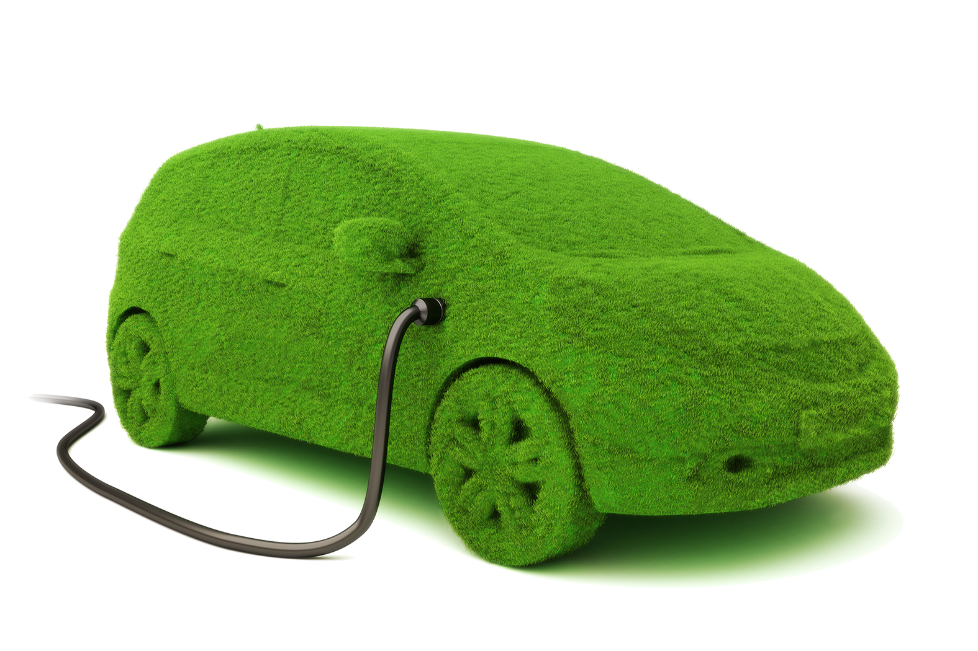
Content
The Norwegian Automobile Importers’ Association
Key facts about Norway
Car ownership and use
The Norwegian car market
The political debate
Autoretur

Slide 3

The Norwegian Automobile Importers’ Association (BIL) represents a large economic significance
26
Members
Appr 900
Dealers
Appr € 20 bn.
Member turnover
Appr 50,000
Member employees

Slide 4
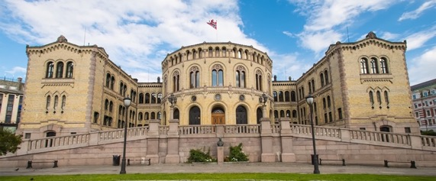
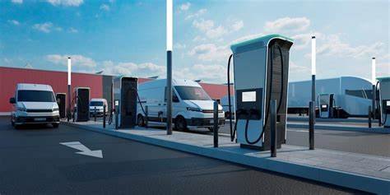
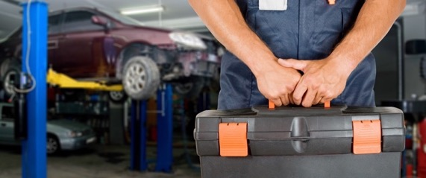
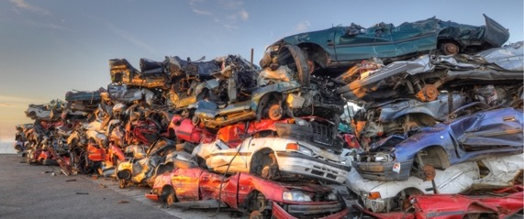
BIL’s key areas
Public affairs – fiscal and regulatory
The automobile’s place in Society
Achieving the climate goals in 2030
New automobile market
Recruiting / diversity
Recycling

Slide 5
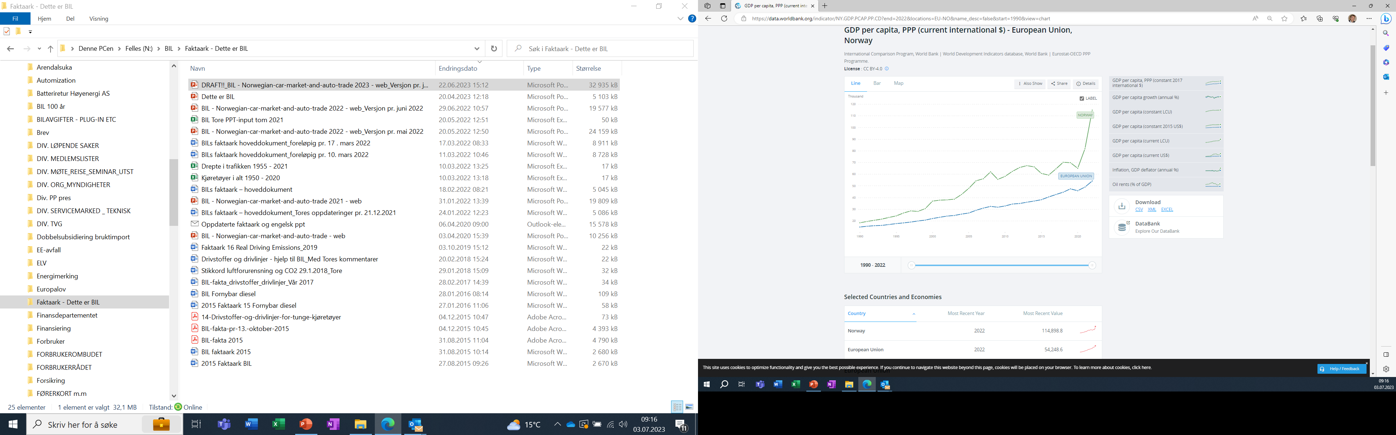
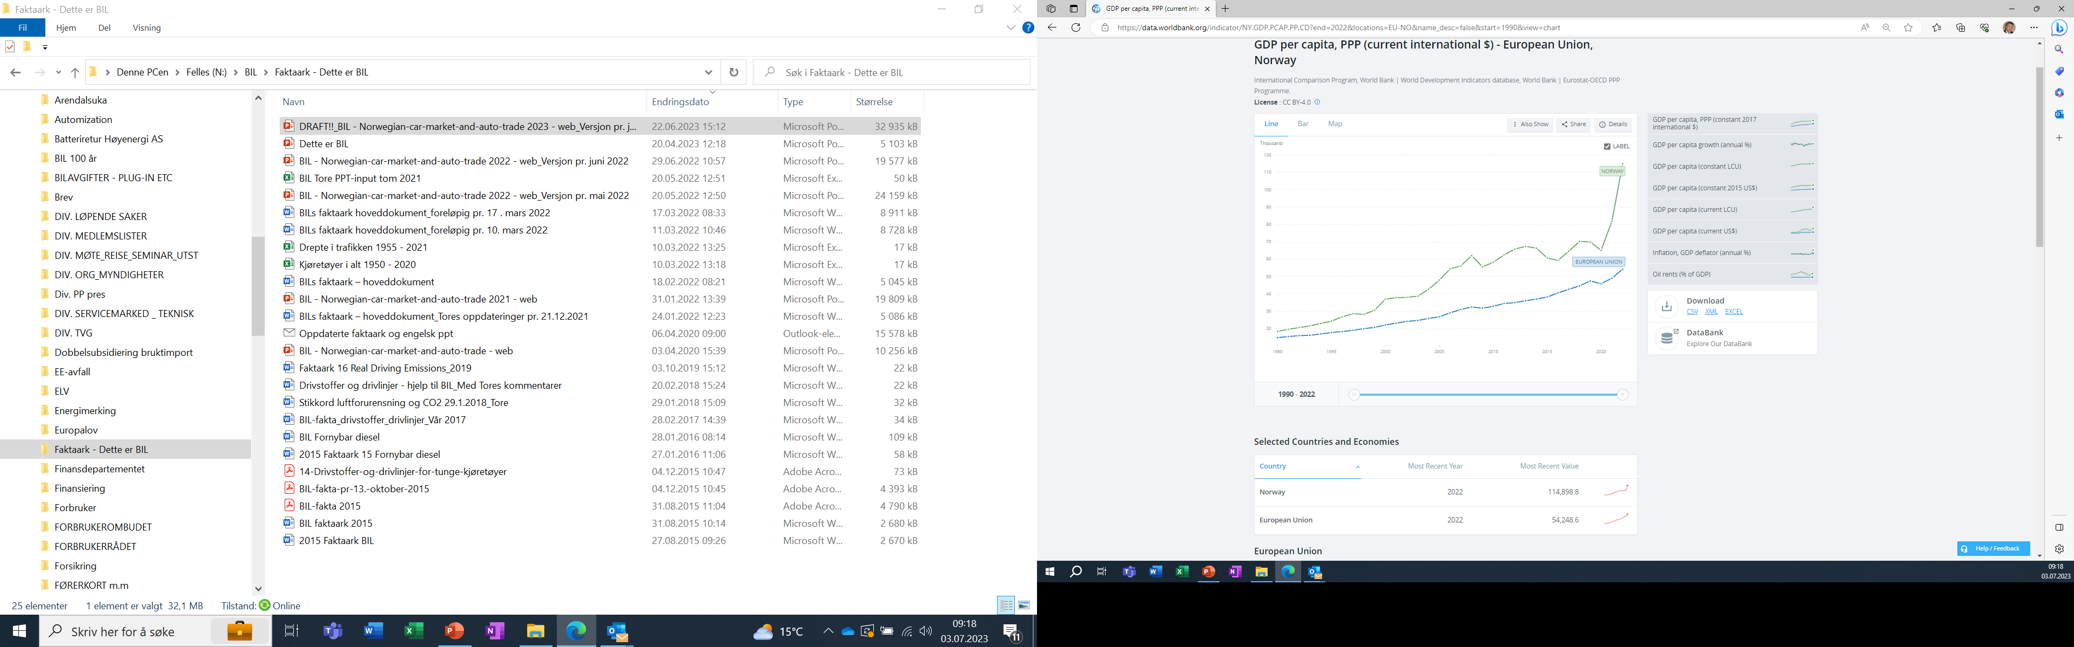
Inhabitants per km2:
109
(2022)
18 (ex. Svalbard)
(2023)
Source: www.worldbank.org

Slide 6
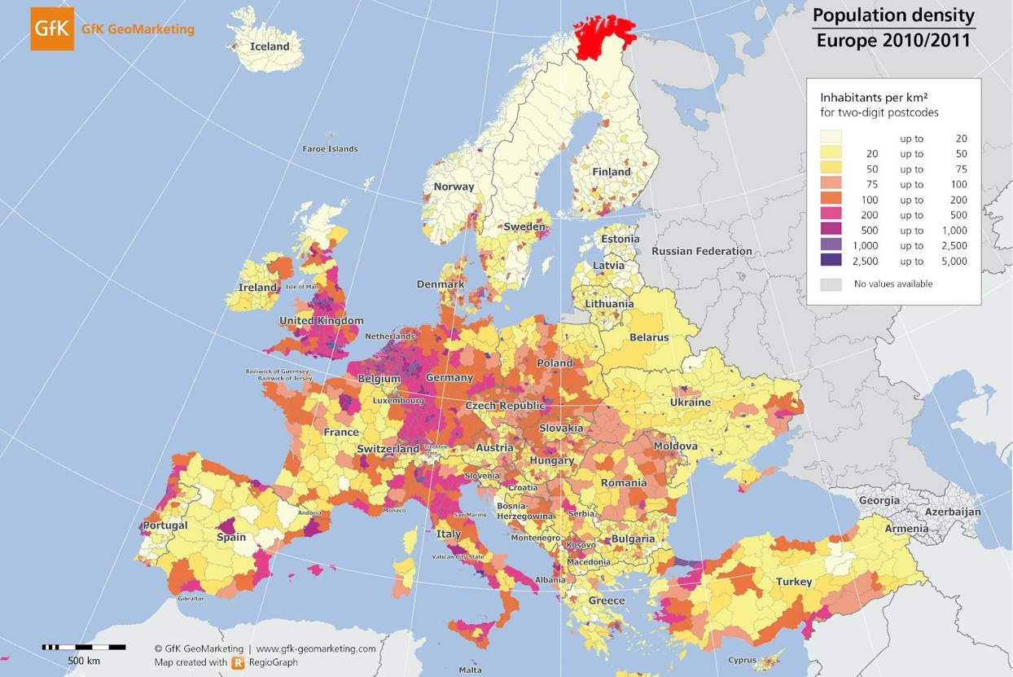
Scattered population
Source: www.ssb.no/kommunefakta
KEY FACTS
(world ranking in parentheses)
Example:
Finnmark county alone is 11 % larger than Denmark, but home to only 75,000 people.
Population
5,5 mill. (118th)
Similar to Barcelona metropolitan area
Area
385,153 km² incl. Svalbard (61st).
Slightly larger than Germany
GDP per capita
$106.000 (2022)

Slide 7
Composition of the car fleet
Source: OFV

Slide 8
Electric passenger car fleet
(point at the dots to see the exact figures)
Source: OFV

Slide 9
New passenger car sales
- by powertrain (percent) Source: OFV

Slide 10
BEV passenger cars - market share
BEV passenger car park
Source: OFV

Slide 11
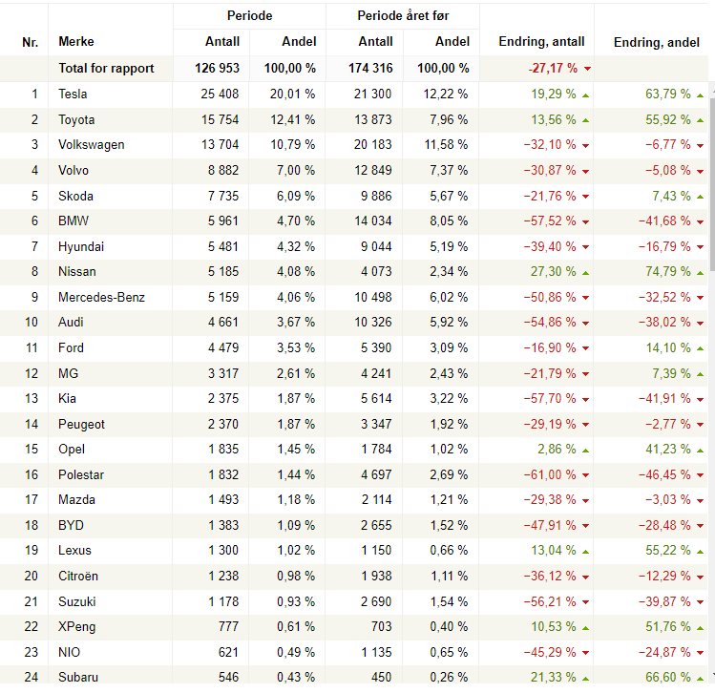
Top selling
car brands in Norway 2023

Slide 12
“The Norwegian family car” is an SUV or estate with 4WD
Source: OFV

Slide 13


Who buys passenger cars?
Source: OFV
Private purchase
55,0%
69 837
Businesses*
45,0%
57 060
2023 figures
*private leasing counts as a business purchase.

Slide 14
Inland passenger transport (in mill. passenger-km, 2022)
Source: SSB

Slide 15
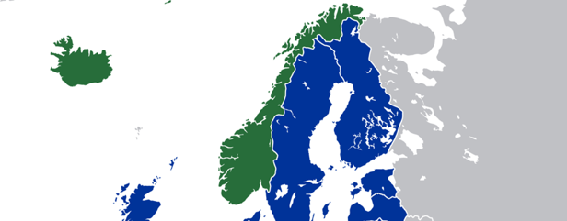


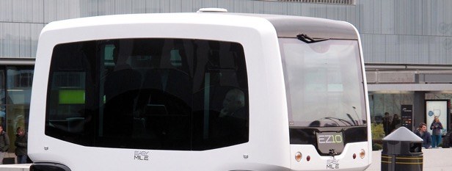
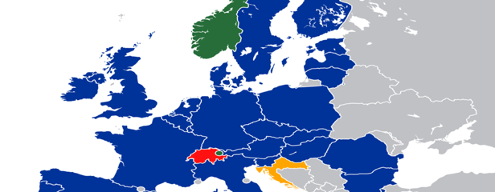
Technical requirements for import
Norway is an EEA member, following EU regulations for all vehicles
Norway does not produce cars, however…
There are only a few exemptions to the EU rules, among them related to the special winter conditions
…there are some Norwegian manufacturers of components and other types of vehicles

Slide 16
Average CO2 emissions per new passenger car (g/km)
Source: OFV

Slide 17
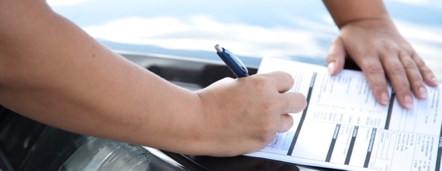
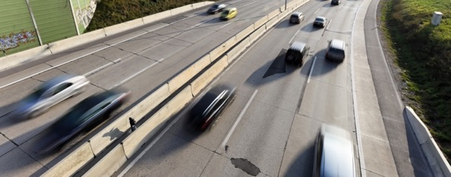
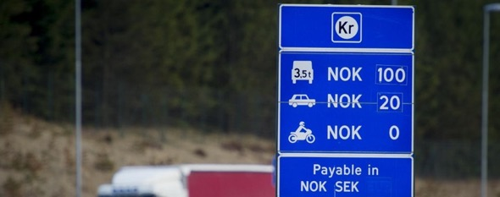
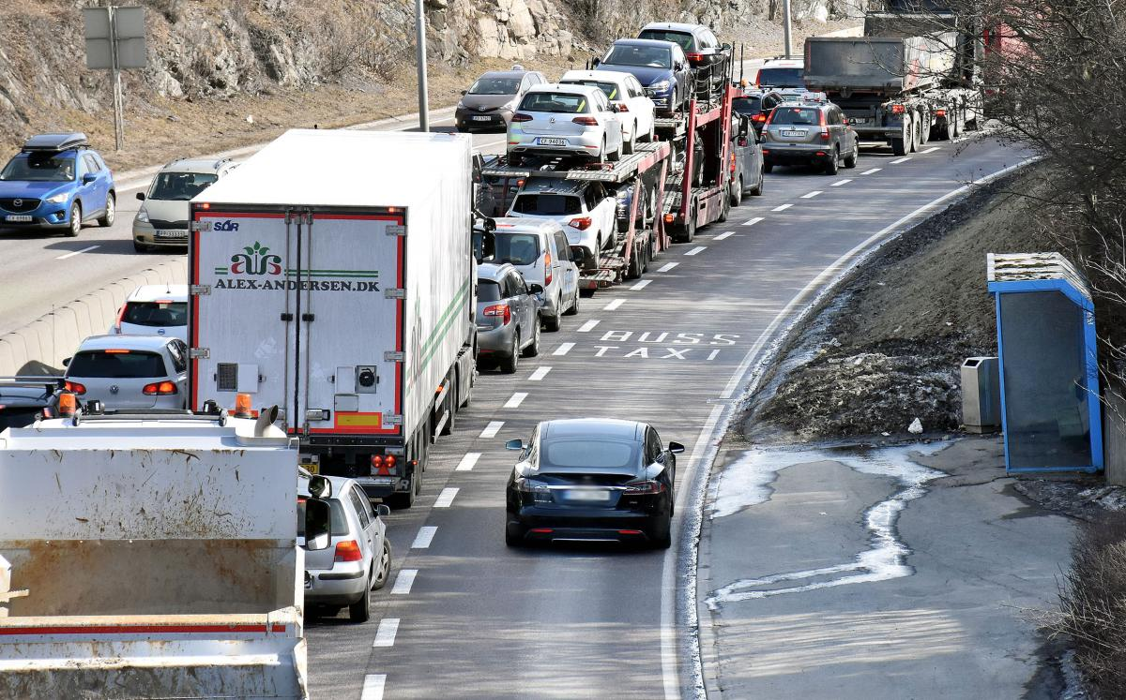
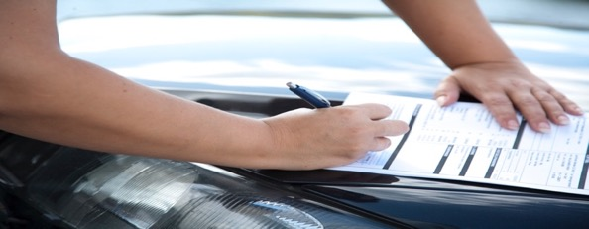
Why is the zero-emission market so big?
Reduced registration tax and VAT
Reduced parking fee in cities
Reduced tax at toll gates and ferry crossings
Access to public transport lanes

Slide 18
Cost of ownership and use for a passenger car at
NOK 480.000 (approx. 45.000 €), driving 15.000 km/year
Source: OFV
Drivetrain | NOK/year | NOK/month | NOK/km | Difference in NOK compared to BEV
BEV | 99 582 | 8 298 | 6,64
Plugin hybrid | 112 638 | 9 387 | 7,51 | 13 056
Diesel | 121 012 | 10 084 | 8,07 | 21 430
Petrol | 122 973 | 10 239 | 8,19 | 23 391

Slide 19
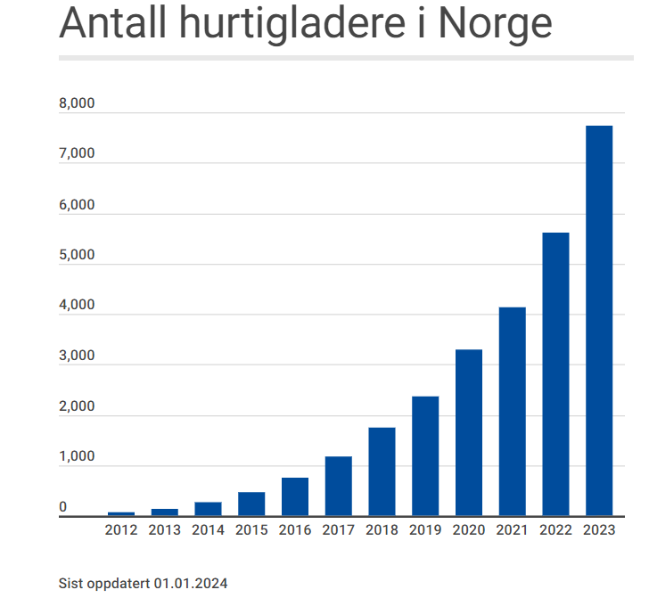
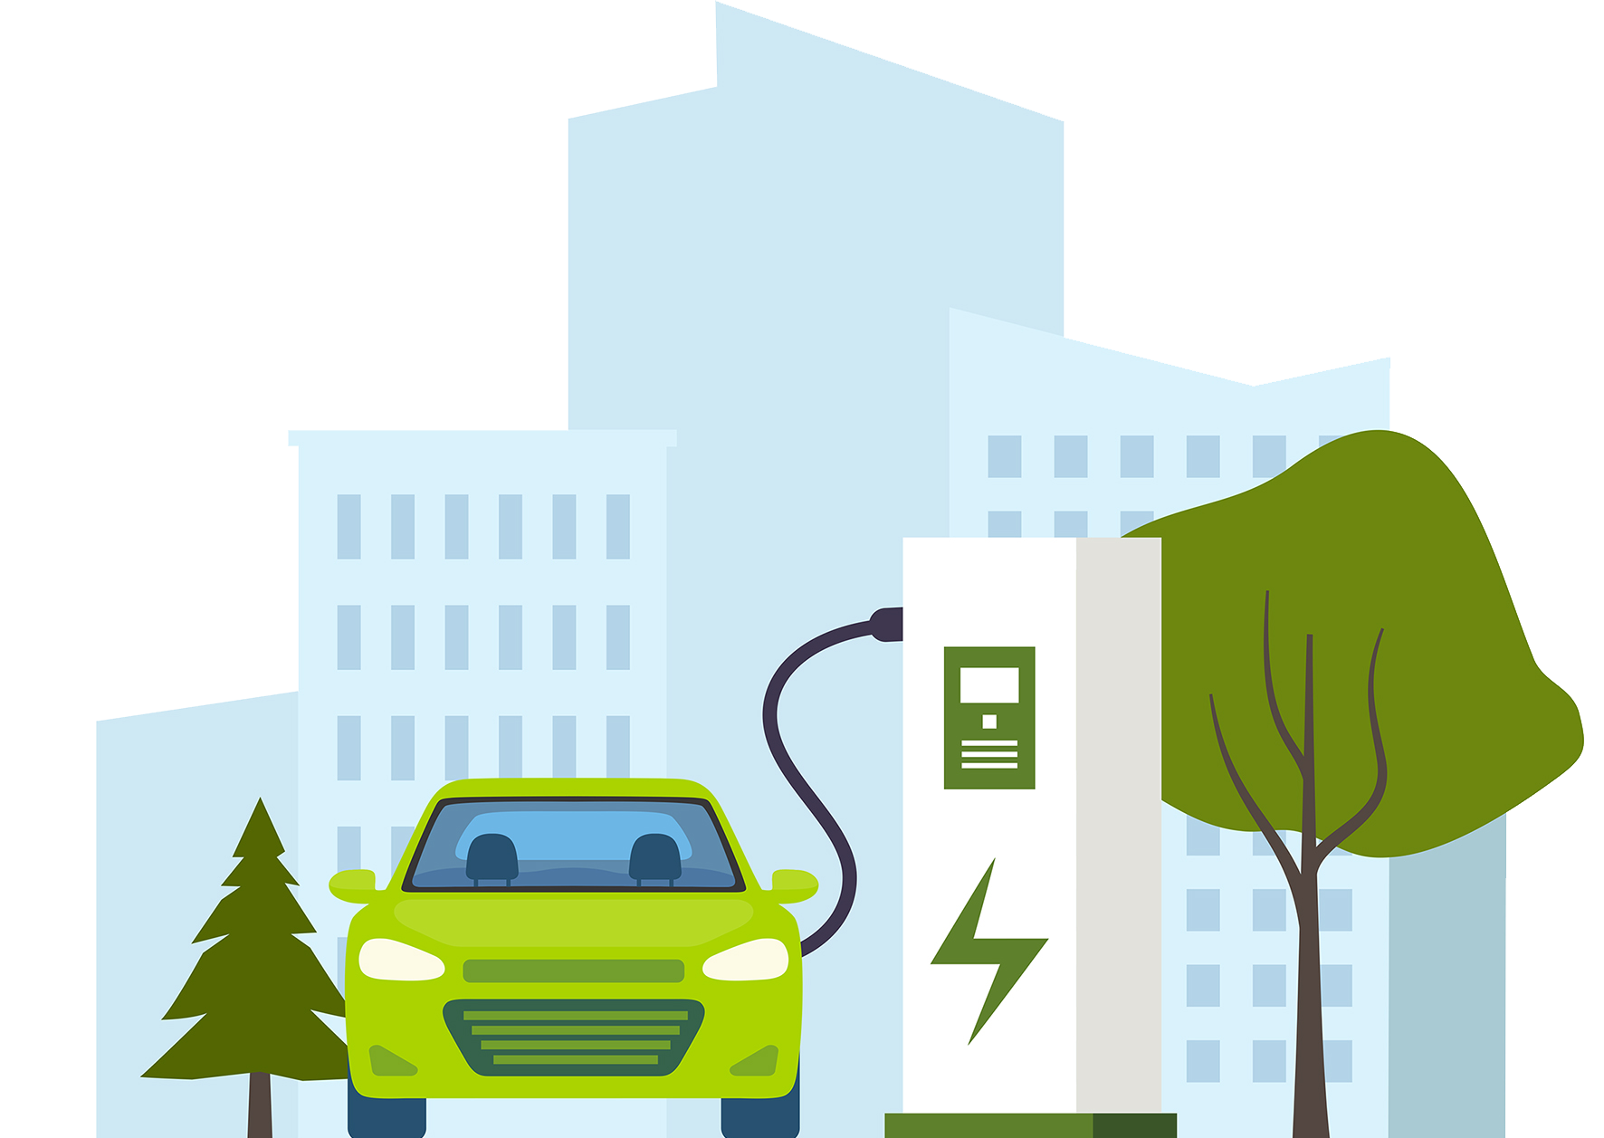
Expanson of the charging network
Fast chargers in Norway

Slide 20
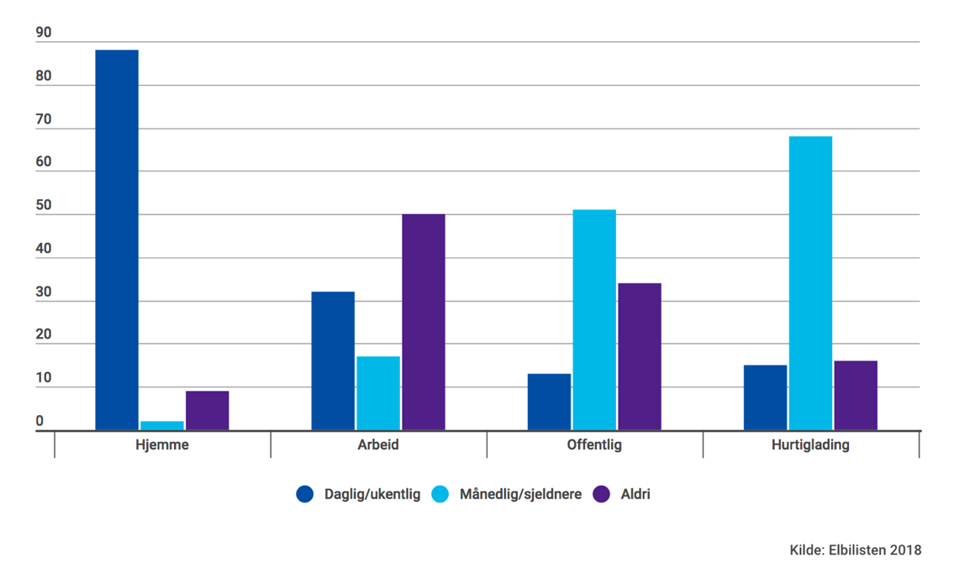
9 out of 10 charge at home
89 % of EV owners charge at home, daily or weekly
In 2024, there are less then 100 EV cars per fast charger

Slide 21
Political goals and challenges
Goal: Cut emissions from the transport sector by 55 % within 2030
  Objective 1: Reduce average CO₂-emissions from new cars to 85 grams/km by 2020; achieved in 2017 - 14 g/km achieved by April 2023
  Objective 2: All new passenger cars should be zero emission from 2025
  June 2023: appr. 85 % zero emission
  According to a report from Oslo Economics, we need 200.000 new EV cars on Norwegian roads every year to achieve these goals.

Slide 22
Taxation and incentives: «The Norwegian way»
Traditionally, cars in Norway are heavily taxed, both when purchased and in use.
Since 2007, taxes for fossile fueled cars have gradually shifted from being based on kWh (power) and weight, to appr. equal shares of CO₂ and weight, in addition to a minor NOx component.
The Norwegian EV policy was for a long time based on no purchase tax, no import tax nor VAT when buying or leasing an EV, and owning benefits such as no or low road tax, free parking, reduced company car tax, and inexpensive green electricity.
From 2023 EVs in Norway pay VAT (25%) for purchase amount above 500.000 NOK (appr. 42.500 €), NOK 12,98 per kg GVW, 100 % company car tax and, due to increased integration via enhanced North Sea cables into the EU grid, electricity is no longer inexpensive.

Slide 23
The political debate towards and beyond zero emmisions
The political support for the government’s EV policies and incentives are huge, and most people now think it’s fair that EVs should pay some tax.
The Norwegian EV policy comes with a cost. Car-related taxes in Norway dropped from almost 80 bill. NOK in 2007 to 40 bill. NOK in 2022
With zero emission comes the need for a new taxation scheme for cars/driving. How we tax buying and driving cars in the future, is a hot political topic in Norway.
Predictability is key for the car industry and consumers. BIL argue that changes must happen in small steps and with long perspectives.

Slide 24
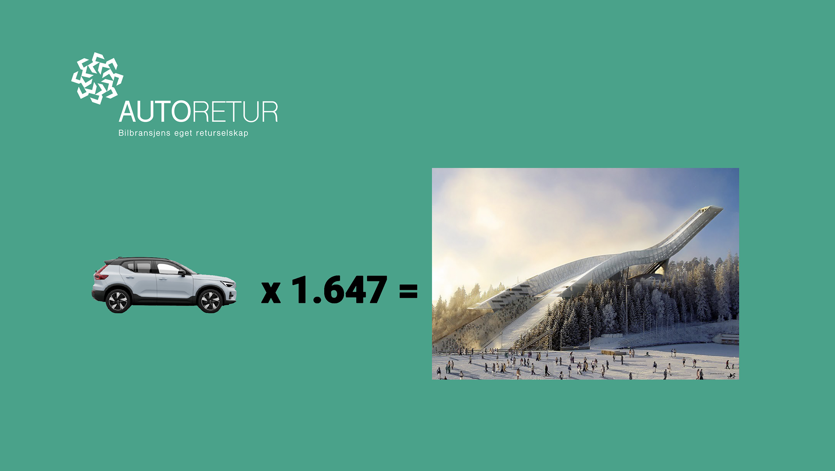

Slide 25
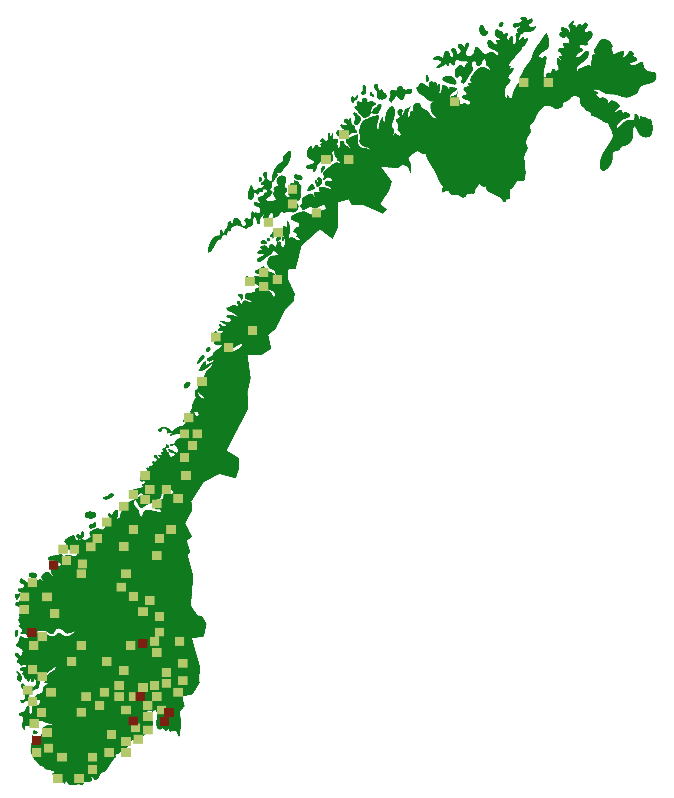
The role of Autoretur:
Autoretur AS is a non-profit company that, on behalf of car importers, collects
and recycles all Norwegian scrap vehicles
Autoretur is 100% owned by BIL (Norwegian Automobile Importer Association)
Autoretur established in 2004 – operational from 2007
(took over for SFT)
Autoretur has three main operators
The main operators' network consists of approximately
140 car collectors throughout the country

Slide 26
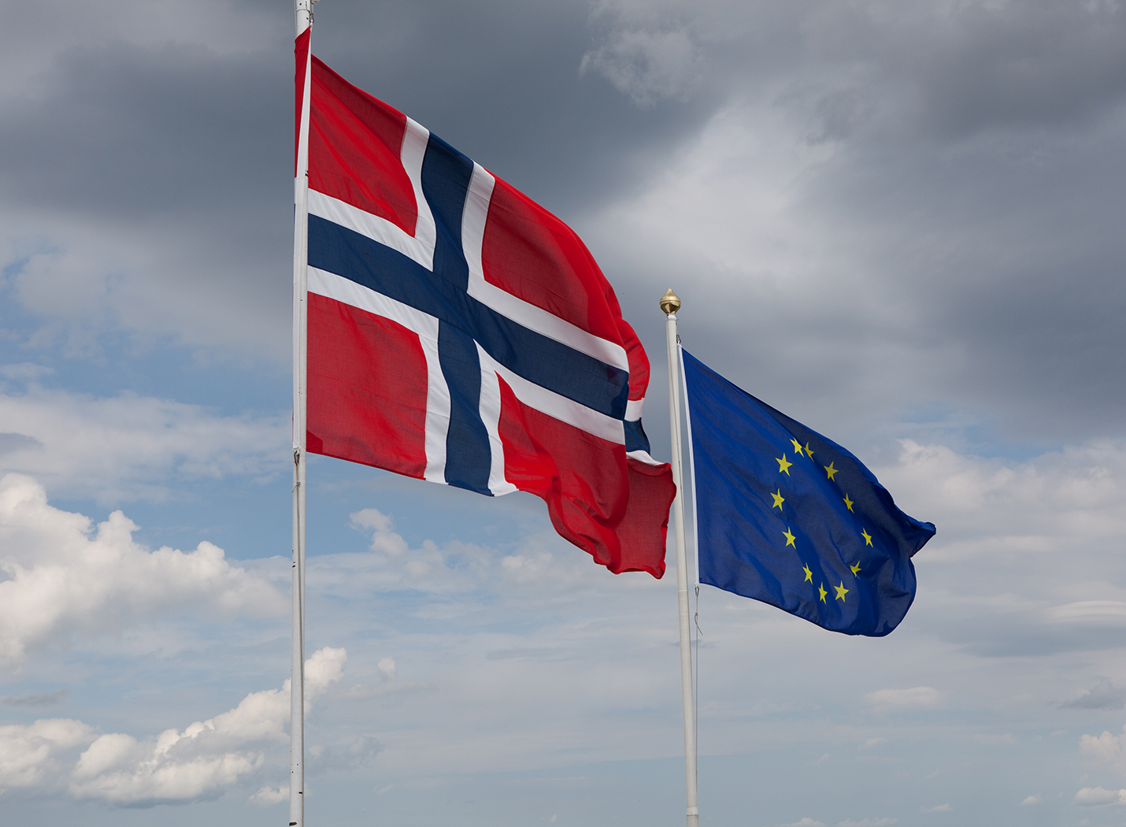
The EU and the authorities' requirements
The basis for Autoretur is the EU's ELV directive, the waste regulations and
producer responsibility as well as Norwegian laws and regulations on waste management
The ELV, "End of Life Vehicle" directive describes how discarded cars must be handled and recycled
Norway's obligations towards the EU are further defined in Norwegian environmental and climate policy - which sets recycling requirements (85% material recycling rate and 95% total recycling rate)
Producer responsibility imposes responsibility on producers and importers for the products
throughout the entire cycle
The authorities pay out a “last owner fee” for the scrapped cars

Slide 27
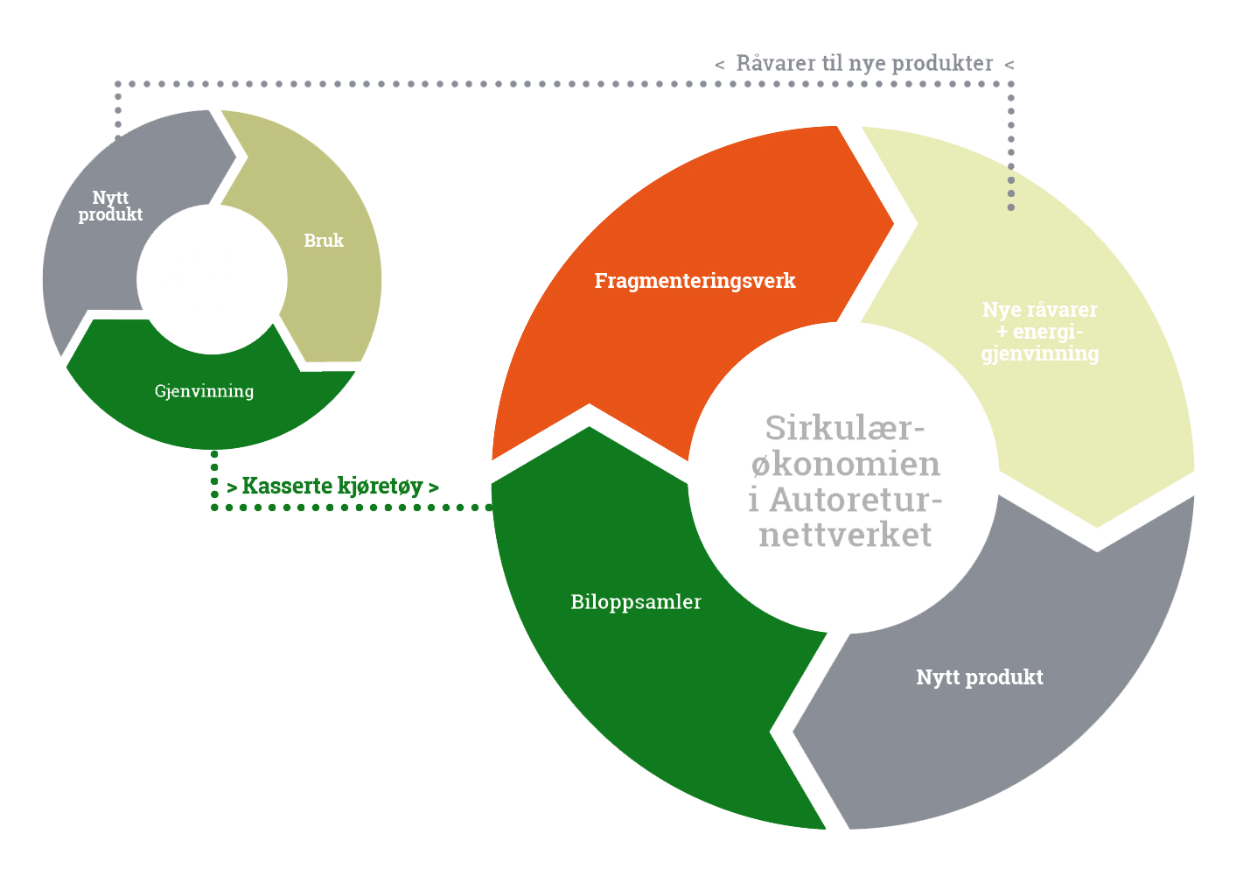
Circular economy, reuse
processes and sustainability
Through the Autoretur network's recycling processes, a sustainable circular economy is ensured.
In 2022, the recycling rate was 97.8 percent*
In 2022, 88,2 percent of the scrap cars' materials were recovered and used for something new*
Source: www.autoretur.no

Slide 28
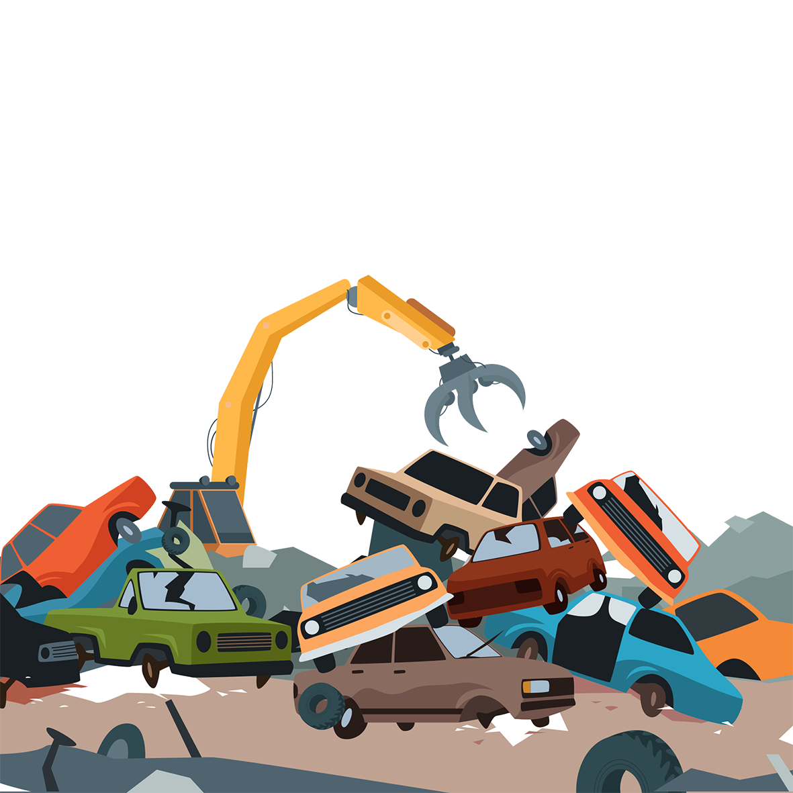
The recycling account for 2022
Reuse | Material- recycling | Energy- recycling | Recovery rate | Deposit | SUM
12 650 329 | 131 815 257 | 15 665 197 | 160 130 782 | 3685 782 | 163 815 879
7,7 % | 80,5 % | 9,6 % | 97,8 % | 2,2 % | 100,0 %
Number of ELVs= |  | 117 067
Total weight (kg)= |  | 163 815 879
Source: www.autoretur.no

Slide 29
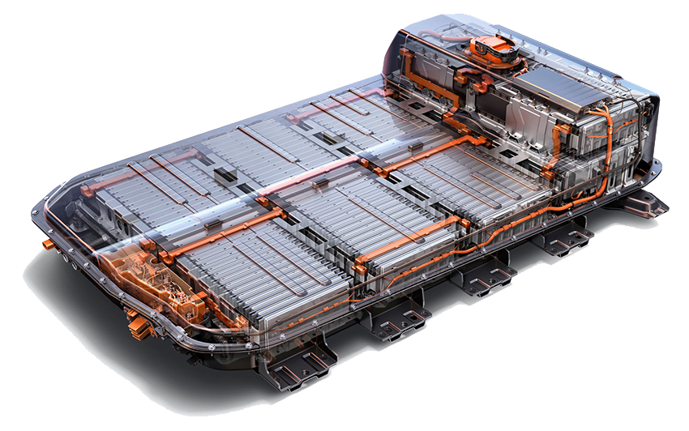
Batteriretur – recycling batteries
Norway’s significant number of electrical vehicles requires an effective system for recycling of big and complicated battery packages.
BIL has a framework agreement with AS Batteriretur. Automobile importers make use of this when handling discarded/defective batteries.
This system is adapted to the different brands and models.
Batteriretur is rapidly developing and expanding its business, parallel to the market and technical developments.
From other countries, and from the manufacturers, Norway is being looked at as a “pilot”.

Slide 30
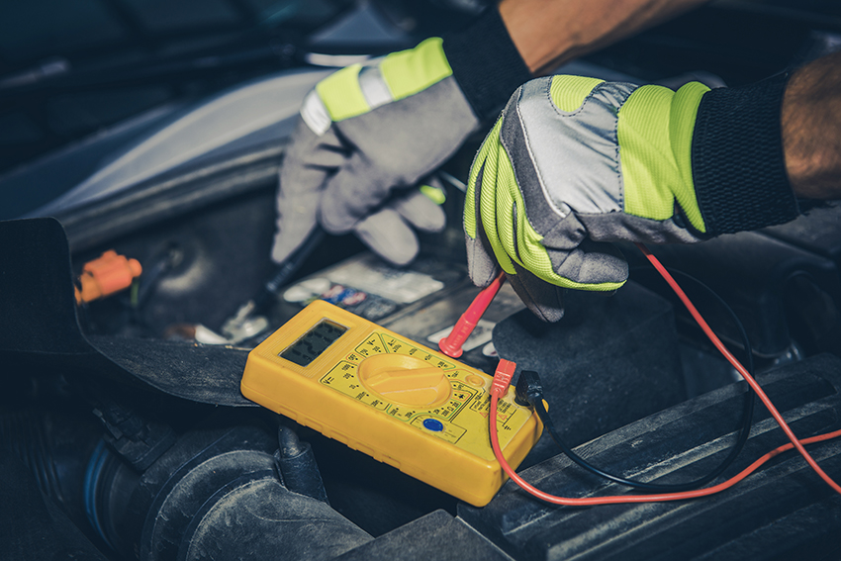
Boosting the car mechanic trade
BIL takes part in efforts to boost the image and reputation of the car mechanic trade and professions.
Important to ensure that new recruits are motivated and qualified.
This is a partnership with the Norwegian Motor Trade Association, its regional education offices and regional educational authorities, among others.
To become a car mechanic, you spend two years in professional school (high school level), then two years as apprentice in a certified workshop. The Government contributes in the form of regular apprenticeship grants to the participating enterprises.
Our associations conduct several activities to boost the knowledge and the attractiveness of our professions.

Slide 31
THE NORWEGIAN AUTOMOBILE IMPORTERS’ ASSOCIATION
Telefon: 22 64 64 55
www.bilimportorene.no

