Slide 1
OVERBLIKK
HVA SKJER INNEN SELVKJØRENDE BILER
(«Bruttopresentasjon»)
Desember 2023, Tore Lillemork, BIL

Slide 2
INNLEDNING
Det er i dag mulig å typegodkjenne nivå 3 og mulig nivå 4, men med omfattende begrensninger i bruksområder, hastighet, type veier, kun små volumer av biler, osv.
Norge er «på hugget», og har i flere år hatt mulighet for prøveordninger etter godkjenning fra SVV; ref. Brønnøy Kalk i Brønnøysund.
Norge kommer nok til å følge EU etter hvert som det åpnes opp derfra, er mitt inntrykk så langt.
Men: likevel ser jeg en viss / økende skepsis, bl.a. etter Teams-møte med Stein-Helge Mundal fra SVV 27. nov. 2023. Det var han som hadde innlegg om dette på Støtvig i juni 2023.
Han mener å se at industrien forsøker å skyve ansvaret fra seg og over på føreren. Det er ikke mitt inntrykk. Selv om industrien v/ OICA osv. presser på for at det skal åpnes for nivå 3 – 4, er nok enkeltprodusenter mer forsiktige med å gå for fort frem, med tanke på nettopp ansvaret som ligger der når noe skjer.
Som jeg har nevnt, har OICA et mål om å kunne sertifisere / typegodkjenne nivå 3 – 4, uten de fleste av disse begrensningene, innen 2025, men de tror ikke på dette før ca. i 2027. Se senere bilde under OICA.
11.12.2023, Tore Lillemork

Slide 3
Hva gjelder i Norge?
Bilprodusentene trenger oversikt over lokale regler når det gjelder selvkjørende biler
Stedet å henvende seg til fremover er Statens vegvesen (SVV)
SVV har i flere år hatt prøveordning for selvkjørende biler, hjemlet i Lov om utprøving av selvkjørende kjøretøy
Kontakt:
Avdelingsdirektør Espen Andersson
Ekspert Stein-Helge Mundal

Slide 4
Uttrekk fra innlegg av Stein-Helge Mundal,
Statens vegvesen,
Servicemarkedsforum, Støtvig, 16. juni 2023

Slide 11
Litt fra OICA Technical Committee

Slide 12
OICAs Roadmap for Automated Driving Systems (ADS) – pr. OICA Technical Committee 193, Istanbul, 17.-18. oktober 2023
Notes:
EU: “small volumes” og “use case restrictions” – fjernes etter hvert
Sertifisere nivå 4 pr. 2025 / 2026? I hvert fall tydelige ambisjoner om ganske nær forestående – både i industrien og i EU.
ALKS = Automated Lane Keeping System
FRAV = Functional Requirements for Automated and Autonomous Vehicles
VMAD= Validation Method for Automated Driving

Slide 13
ADAS - Driving Assistance
UN R79 (Steering assistance)
Remote Control Parking (RCP) for combination
RCP covers low-speed maneuvers for M and N
Industry official GRVA document
Industry expected to organize technical meeting to address CPs concern
ACSF-B1 Emergency corridor
No progress
New OICA approach:
Work on it in the frame of DCAS regulation.
Carry it back to R79 afterwards, if possible.
New DCAS regulation (Driver Control Assistance Systems)
Agreement to prioritize items in two steps:
Priority 1: - General requirements
- Driver initiated maneuvers (beyond R79)
Priority 2: - System-initiated maneuvers
- Hands-free driving
Priorities still to be finalized. (see EC doc. GRVA-17-25)
1st step for endorsement at GRVA of Jan 2024
Highlights:
DSSAD for DCAS ? (potential collaboration between TF-ADAS and EDR/DSSAD IWG)
Relationship between R79 and DCAS regulation.
Speed limit compliance

Slide 14
ADAS - Emergency Systems
AEBS virtual testing (GRVA/2023/22 and GRVA-17-22)
Proposal from France to regulate the use of virtual testing for approval.
The proposal is building on VMAD NATM.
Concerns from industry, Germany, NL and UK...
Workshop on November 7 (Paris), to address concerns from industry, Germany, NL, UK…
Urban Emergency Braking System (UEBS)
UEBS is on-hold, yet kept on agenda of GRVA
UEBS is subject to progress at GRSG on Emergency Motion Inhibit System (EMIS)
To be monitored
Acceleration Control for Pedal Error (ACPE)
Confirmation that HCVs are excluded from scope
Industry proposal to keep M1 only (exclude N1)
2-steps: low-speed then “high-speed” (up to 30km/h)
Target: endorsement at GRVA of May 2024
Lane Departure Warning Systems (LDWS)
Series 01 to UN R130 endorsed, for March WP29
Add-on of Australian lane markings
Certification / product upgrade for NT 2026, AT 2028
Cross-references to R130 lane markings:
R79: supplements to 03 and 04 series endorsed by GRVA for March WP29 (see previous slides)
R157 ALKS: still to be reviewed

Slide 16
GEVA Chair Highlights
OICA TC-193
October 2023
Pierre Teyssier
Olivier Fontaine

Slide 17
GEVA reporting
Conventional and Assisted systems (L0-L2) OICA pilots
Braking (Endurance brake, EBSIG, e-trailers) P.Teyssier
Steering V.Kenneweg (SBW)
ADAS - Driving Assistance (R79 and DCAS) T.Garczorz
ADAS - Emergency systems (AEBS / ACPE / LDWS) C.Tan / R.Schaefer-C.Tan / P.Teyssier
Automated Vehicles (L3-L5)
ALKS developments R.Schaefer/ A.Rieg (HCVs)
AD Road map P.Teyssier / Cluster 3-5 leaders
Cluster 1 – WP1 - VC Mrs. Parmar
Cluster 2 – EDR & DSSAD J. Stone - M. Mitropoulou (EDR-HCV)
D. Bassan (DSSAD)
Cluster 3 – Certifications of AD S.Kondratas/G.Nitz
Cluster 5 J.Schenkenberger
Connected vehicles
Cluster 4 – CS & OTA K.F.Zastrow
GEVA-ITS mirror group Jan Lühmann

Slide 19
Fra ACEA Round table, General Assembly,
Sao Paolo, oktober 2023

Slide 20
EUROPEAN AUTO INDUSTRY
New technologies, deployment of automated vehicles, new mobility patterns
27 October 2023
OICA Round Table
São Paulo, Brazil
Sigrid de Vries
ACEA Director General

Slide 21
Automation & connectivity
Legislation in europe
In Europe: since 2022, the homologation of highly automated vehicles (level 4) is possible
Limitations on use cases and volume
Current type approval and UNECE regulations prevent large-scale deployment
National legislation necessary to allow AV operation and licensing
Initiatives in France and in Germany
Other European states show limited interest so far
Connected vehicles are a reality
Main uses: information, entertainment, navigation
ITS for safety purposes: still limited – no legislative mandate to guarantee Europe-wide ITS infrastructure

Slide 22
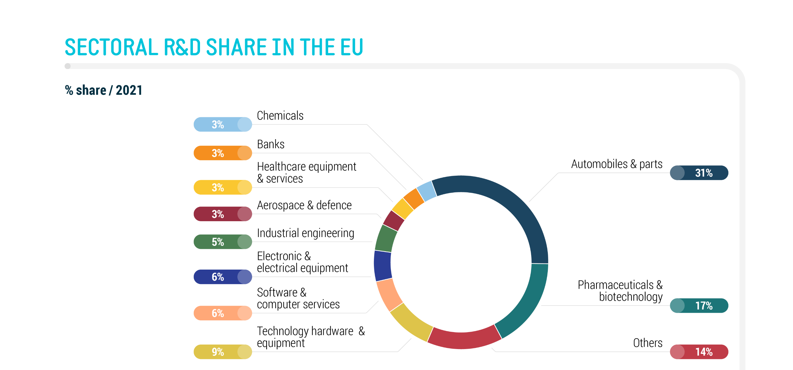
automation
In the real world
Automation is seen by the motor industry as a high potential technology
Promise of greater safety, comfort, and better road usage
Part of the solution to commercial driver shortages
Enabling new forms of mobility for elderly and disabled users
Driving European competitiveness and innovation capabilities

Slide 23
automation
Highly automated applications are becoming clearer
Already a reality: automated valet parking, commercial yard operations
In the future: hub to hub freight transport, passenger services, last mile delivery, private vehicles on highways

Slide 24
Challenges to automation
In Low to middle income nations
Market reality: the business case for automation
Cost and availability of labour vs cost of automation
Is there a real demand or need for automation on those markets?
Inadequate infrastructure
Road markings, signage needed by self-driving systems: often lacking
Strong connectivity needed to provide services based on automation
In some countries: demanding driving environments
Unconventional traffic patterns
Varying respect of the rules of the road

Slide 25
AFFORDABILITY
A growing challenge in times of technological transition
EV batteries and other alternatives remain expensive
Tech content continues to increase
Competition to provide customers with more features
Regulations mandate more systems
Advanced technology as a way towards affordability?
Active safety could reduce the need for complex collision mitigation
Greater mechanical simplicity in EVs
Smaller, lighter, cheaper: do we need a new approach to personal vehicles?
A matter of reflection for the European industry today

Slide 26
The rise of software
software-defined vehicles
Software: the future foundation of the vehicle
All vehicle functions controlled by software as opposed to specialised electronics
A source of greater flexibility, customisation, and lower hardware costs
A source of new challenges for manufacturers: development processes, talent availability and retention, cybersecurity
Software-defined vehicle research ongoing in Europe
Potential for better standardisation of in-vehicle software interfaces
Joint research efforts between EUCAR and the European Commission

Slide 27
Litt mer bakgrunn – teknologisk utvikling

Slide 28
Trender
“The software-defined vehicle is the next evolutionary step in the automotive industry” (Continental)

Slide 29
(Kilde: Aptiv)
5G

Slide 30
Bilens software over the air (SOTA)
“The average modern car has up to 150 electronic control units (ECUs) running up to 100 million lines of code. In comparison, the F-35 fighter jet had fewer than 25 million lines of code” (Analog.com)

Slide 31
DATA FRA BILER / CONNECTIVITY
Hvordan / hvem håndtere data fra biler?
«Access to in-vehicle data»
Stadig mer OTA (Over The Air) - «over hodet» på så vel forhandler som importør?
Oppdatering av soft-ware, mer effekt, utstyr / funksjoner
Selvkjøring
5G
AI
CS (Cyber Security
GDPR

